Slide 1
Deep Learning algorithms

Slide 2
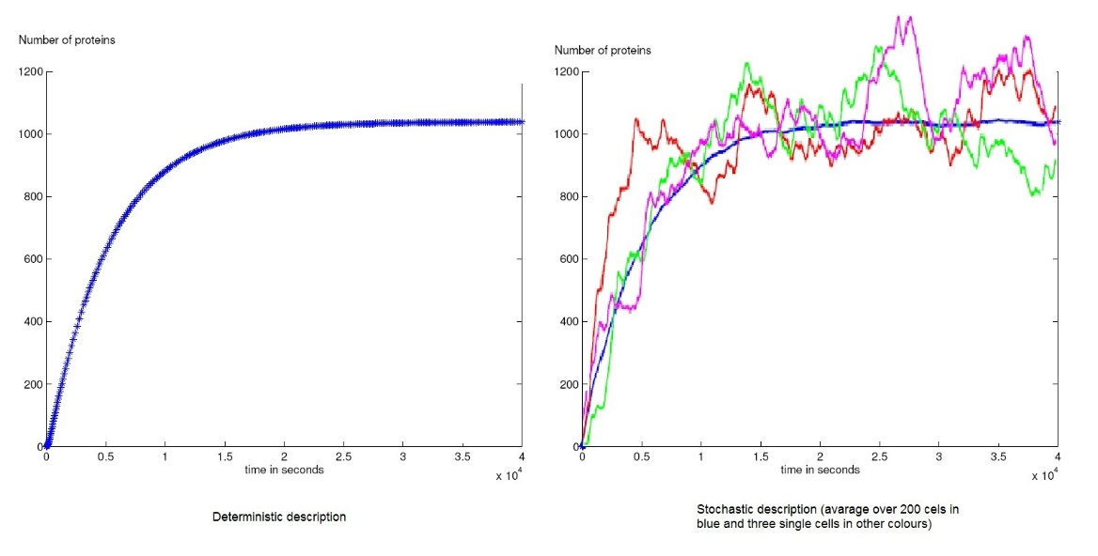
Deterministic vs. stochastic models • In deterministic models, the output of the model is fully determined by the parameter values and the initial conditions. • Stochastic models possess some inherent randomness. The same set of parameter values and initial conditions will lead to an ensemble of different outputs. • Obviously, the natural world is buffeted by stochasticity . Stochastic models are considerably more complicated.
https://www.quora.com/What-are-stochastic-and-deterministic-processes-And-how-can-I-learn-more-about-these

Slide 3
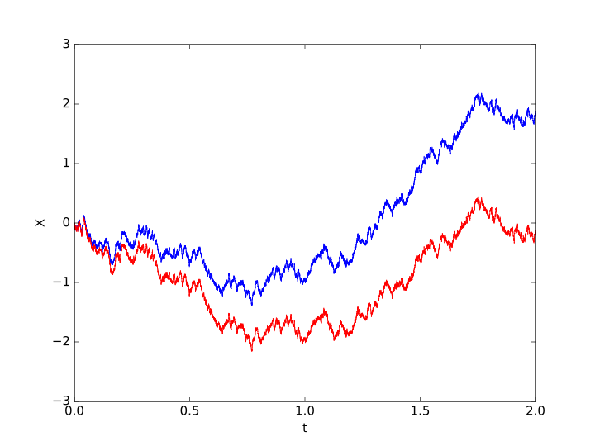
https://en.wikipedia.org/wiki/Stochastic_process

Slide 4
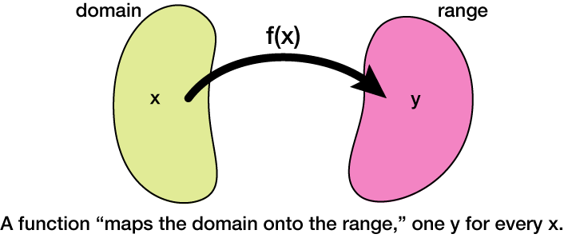
http://xaktly.com/MathFunctions.html

Slide 5
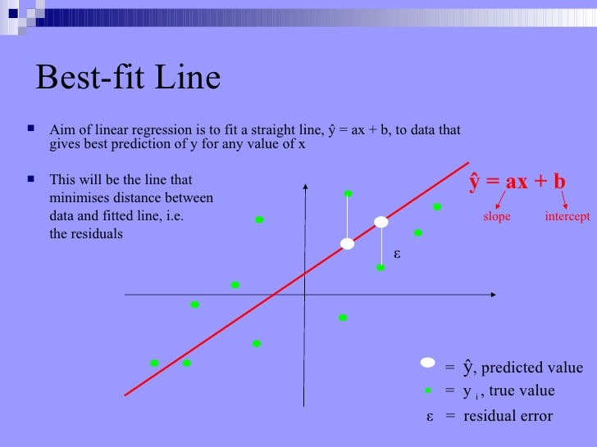
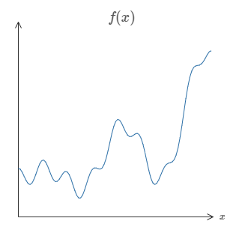

Slide 6
The brain .. And neurons ..and imperfect analogy

Slide 7
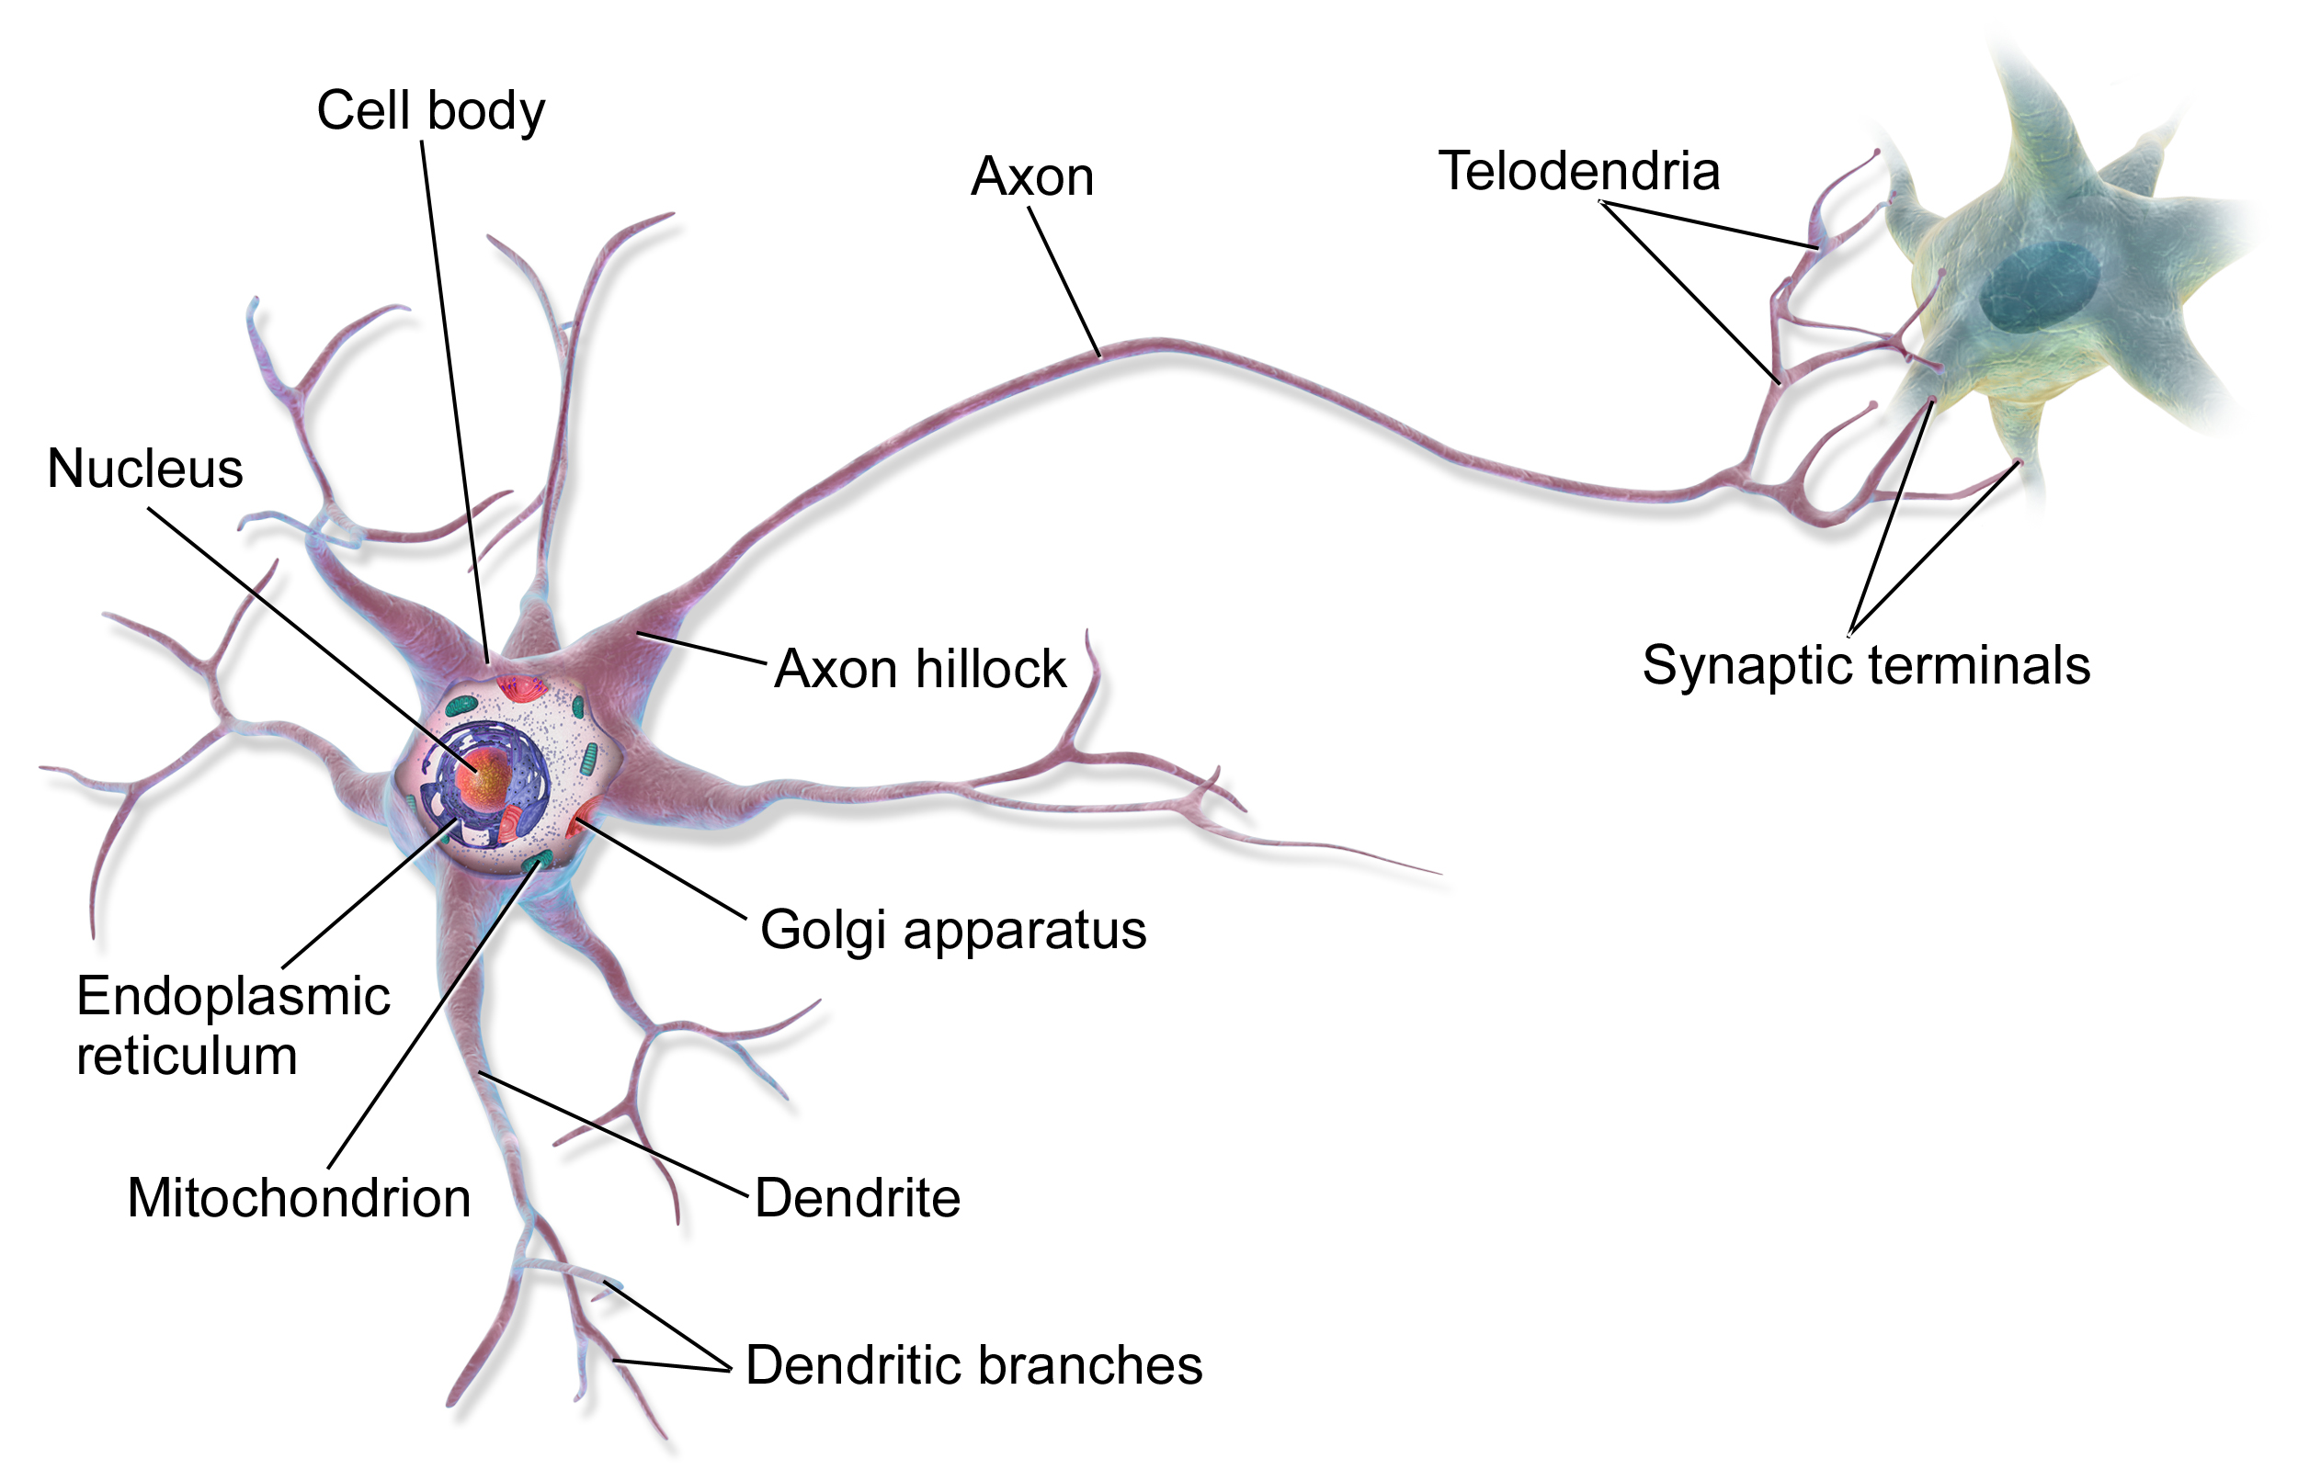
Image source: wikipedia

Slide 8
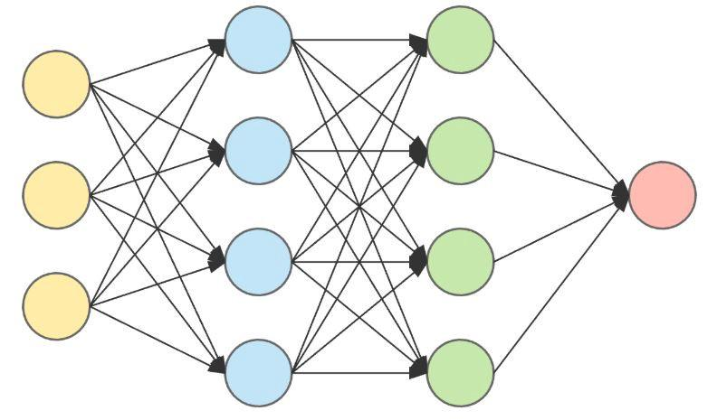
Image source: wikipedia

Slide 9
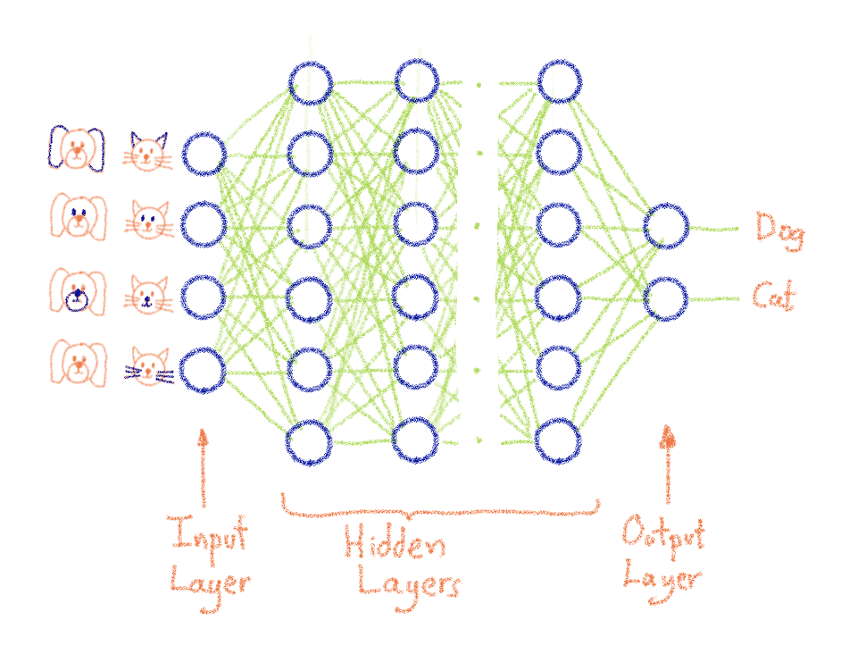
Image source: https://www.ovh.com/blog/what-does-training-neural-networks-mean/

Slide 10
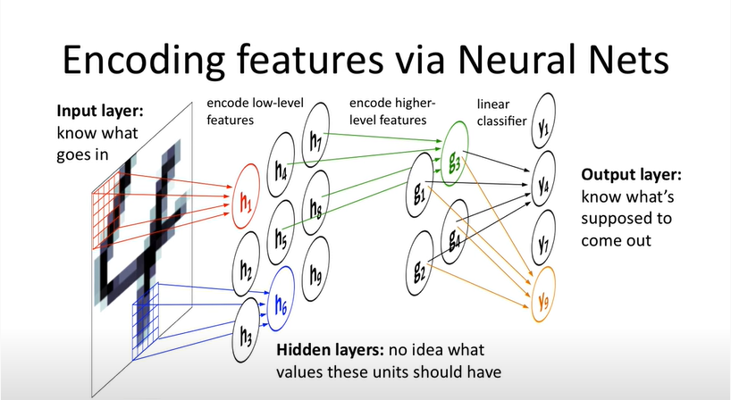
Image source:https://www.youtube.com/watch?v=YMsci1HYDjs

Slide 11
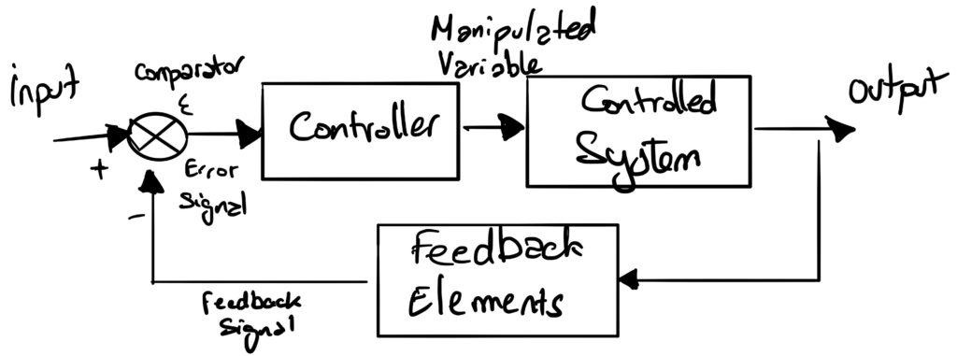
Image source: https://www.ovh.com/blog/what-does-training-neural-networks-mean/

Slide 12
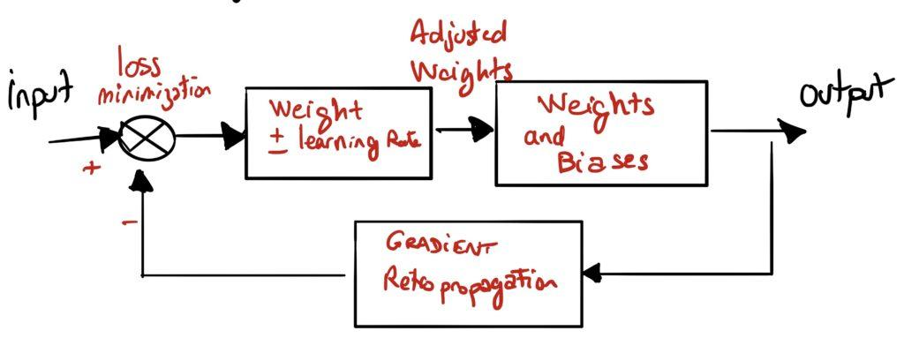
Image source: https://www.ovh.com/blog/what-does-training-neural-networks-mean/

Slide 13
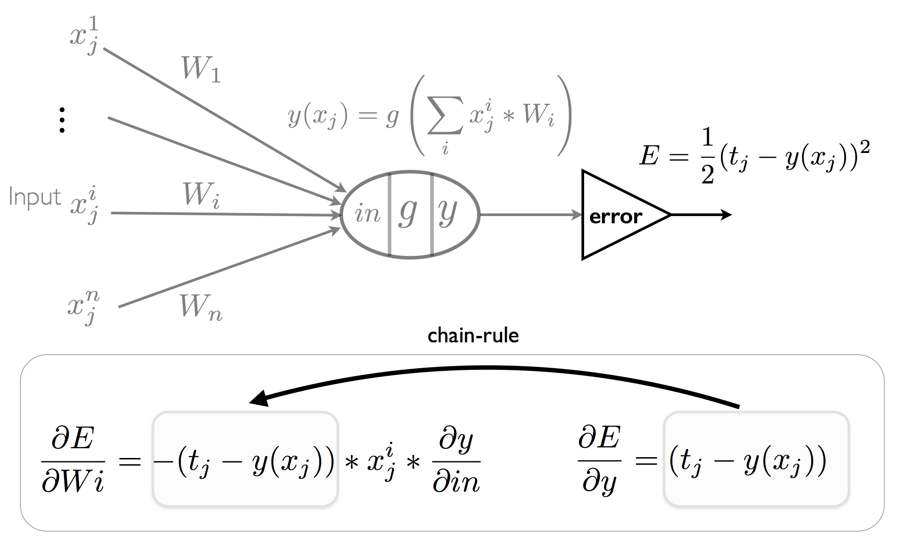
Image source:https://plato.stanford.edu/entries/artificial-intelligence/neural-nets.html

Slide 14
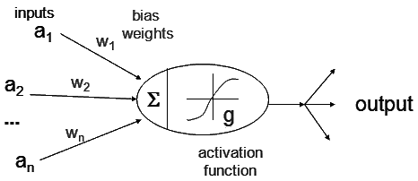
Image source: https://www.cs.iusb.edu/~danav/teach/c463/12_nn.html

Slide 15
Why bother ..

Slide 16
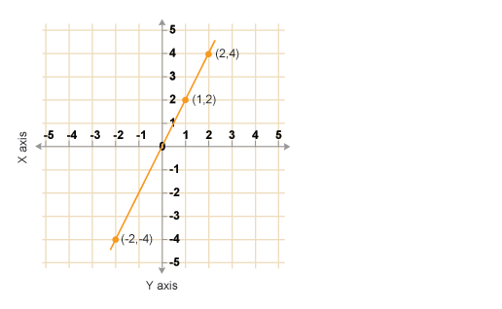

Slide 17
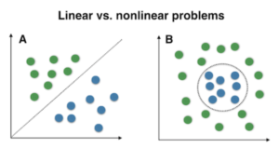
Image source: stack overflow

Slide 18
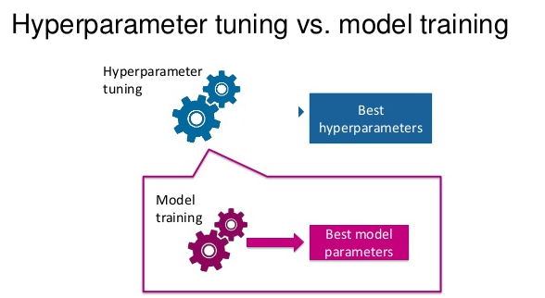
Image source:https://towardsdatascience.com/understanding-hyperparameters-and-its-optimisation-techniques-f0debba07568

Slide 19
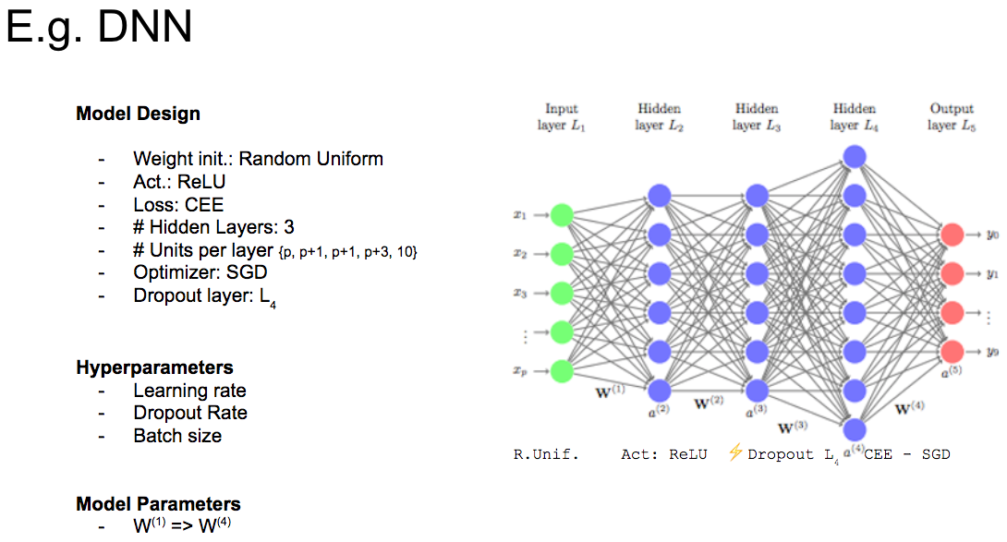
Image source: https://blog.floydhub.com/guide-to-hyperparameters-search-for-deep-learning-models/

Slide 20
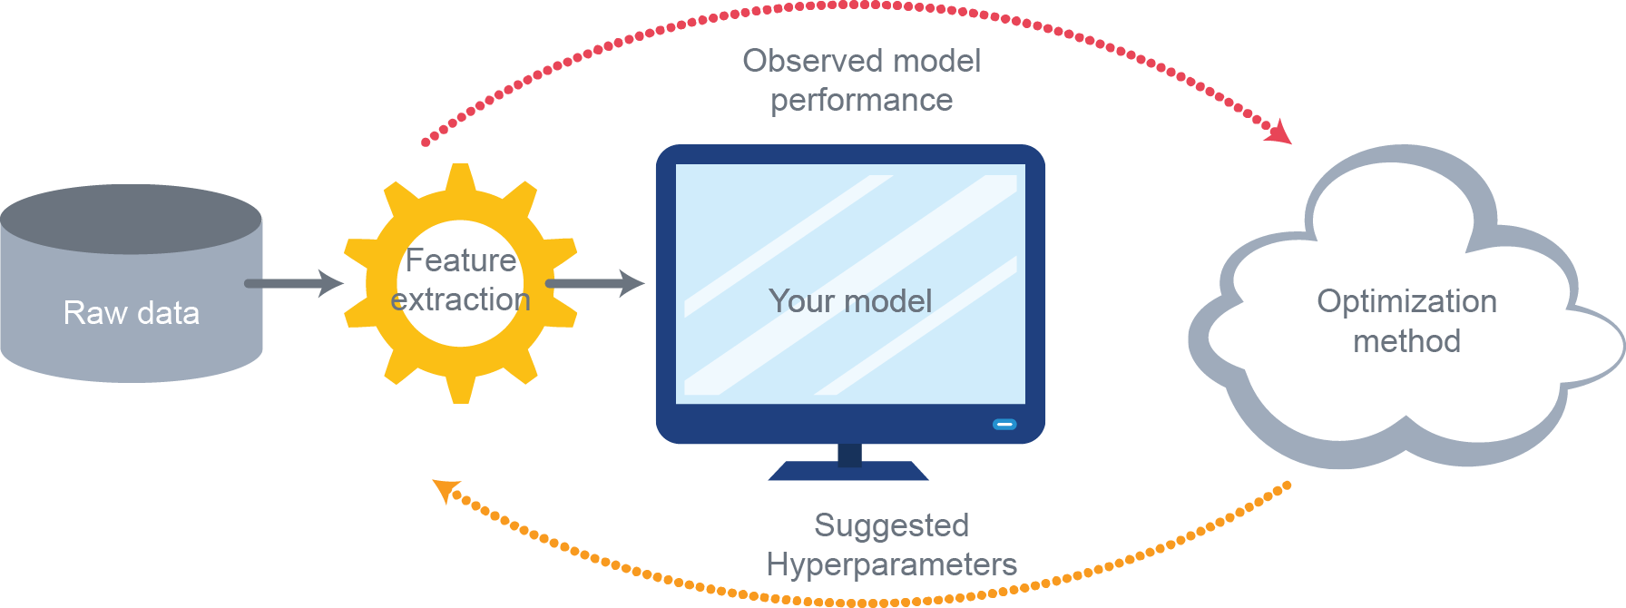
Image
https://sigopt.com/blog/common-problems-in-hyperparameter-optimization/

Slide 21
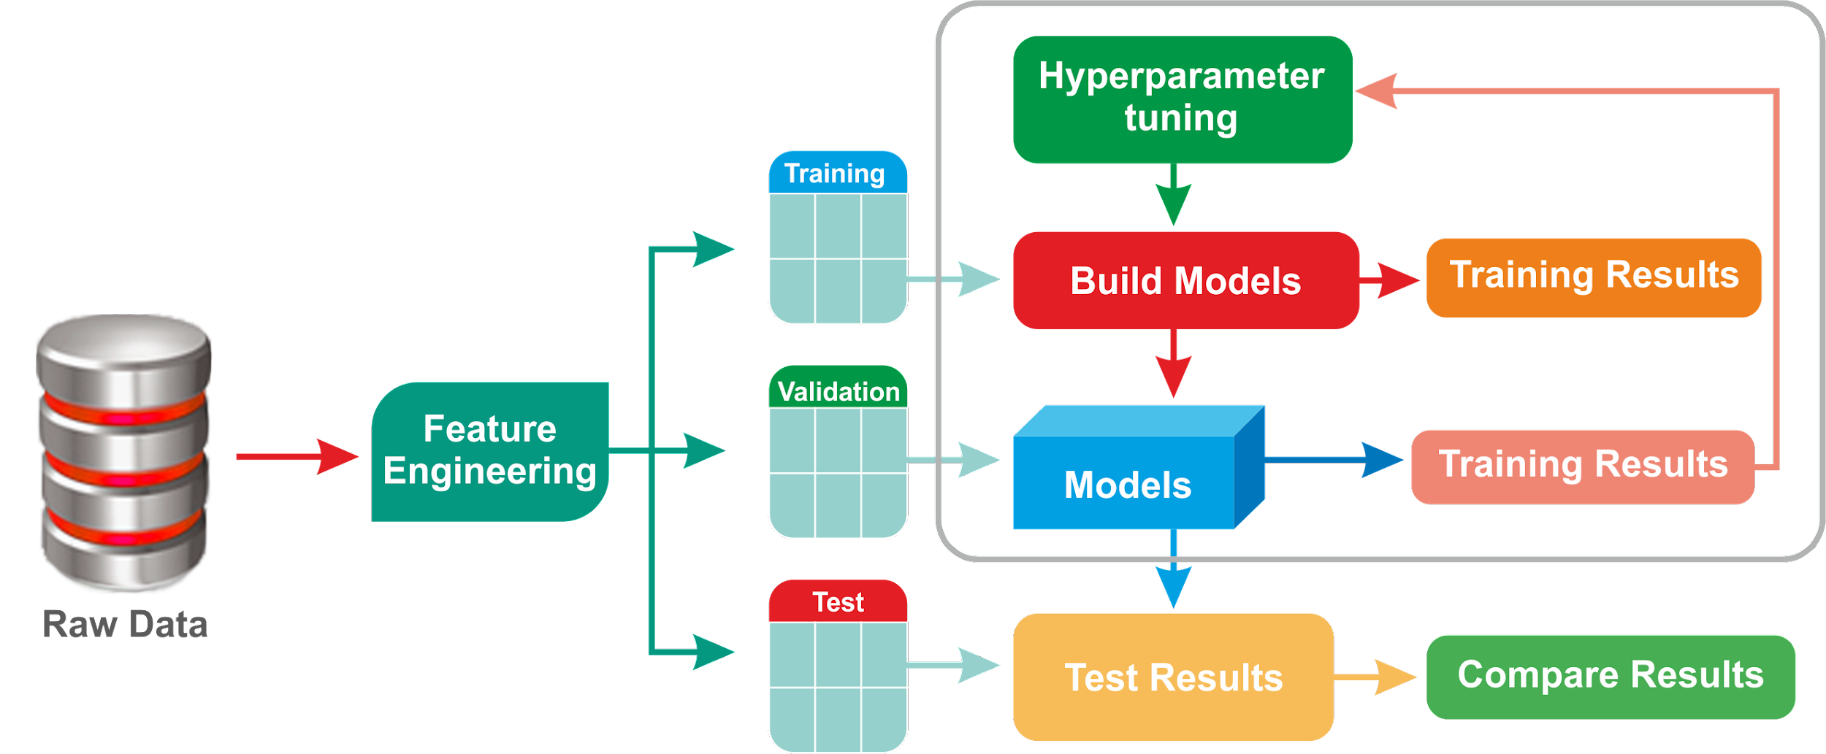
Image
https://subscription.packtpub.com/book/big_data_and_business_intelligence/9781788479042/1/ch01lvl1sec11/hyperparameter-tuning-and-cross-validation

Slide 22
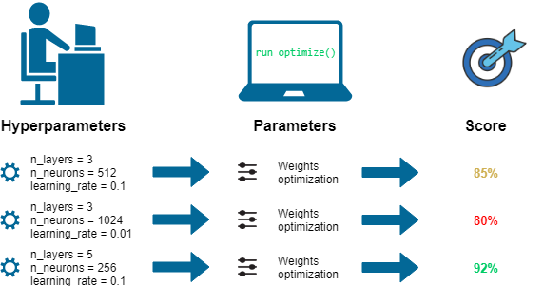
Image source:
https://towardsdatascience.com/hyperparameters-optimization-526348bb8e2d
https://dkopczyk.quantee.co.uk/hyperparameter-optimization/
https://stats.stackexchange.com/questions/309729/what-are-the-real-hyperparameters-of-a-neural-network
https://deepai.org/machine-learning-glossary-and-terms/hyperparameter

Slide 23
What is learning ..

Slide 24
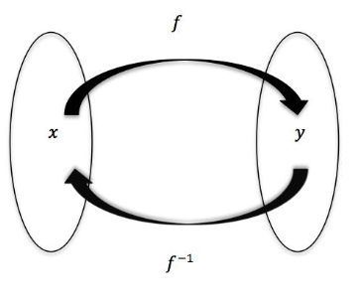
Linear Regression
Let us first start with the idea of ‘learning’. In Machine Learning, the process of learning involves finding a mathematical function that maps the inputs to the outputs.
Source: http://www.math.toronto.edu/preparing-for-calculus/4_functions/we_4...

Slide 25
In the simplest case, that function is linear
What is a Linear Relationship?
A linear relationship means that you can represent the relationship between two sets of variables with a straight line. Many phenomena represent a linear relationship. For example, the force involved in stretching a rubber band. We can represent this relationship in the form of a linear equation in the form:

Slide 26
y = mx + b
Where:
“m” is the slope of the line,
“x” is any point (an input or x-value) on the line,
and “b” is where the line crosses the y-axis.

Slide 28
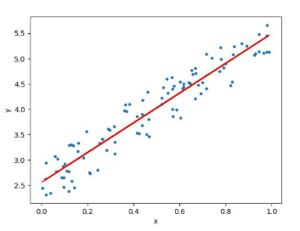
It can be represented as below:

Slide 29
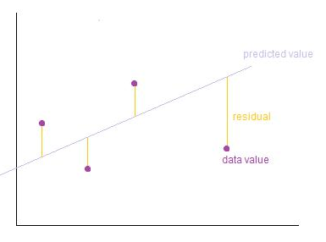
Image Credits: http://wiki.engageeducation.org.au/further-maths/data-analysis/resi...

Slide 30

To define and measure the error of our model we define the cost function as the sum of the squares of the residuals. The cost function is denoted by
Credits: http://www.wbur.org/radioboston/2013/09/18/bostons-housing-challenge
Multiple linear regression can be illustrated in the commonly used Boston Housing Dataset

Slide 31
Deep Learning – a highly
parameterised model

Slide 32
One final aspect of the model we can infer is – MLP (Deep Learning) is an example of a highly parameterised model. Considering our example of finding the price of a house based on a set of features, for the equation y = mx + c, the quantities m and c are called the parameters. We derive the value of the parameters from the data and the strategy for solving the equation. In contrast, hyperparameters are set in advance A hyperparameter is a parameter that is set before the learning process begins. These parameters are tunable and can directly affect how well a model trains.

Slide 33
The parameters of an equation can be seen as the degrees of freedom. Linear regression has a relatively smaller number of parameters. However, the more complex MLP has a much wider range of parameters (degrees of freedom). Both are parameterised models, but MLPs follow a more complex optimisation strategy (back propagation and gradient descent) than Linear Regression (least square). More degrees of freedom also means that more complex problems can be learnt and inferred

Slide 34
In this sense, neural networks can be seen as a complex evolution of linear regression. The highly parameterised nature of multilayer perceptrons allow for the modelling of complex functions.

